Slide 1
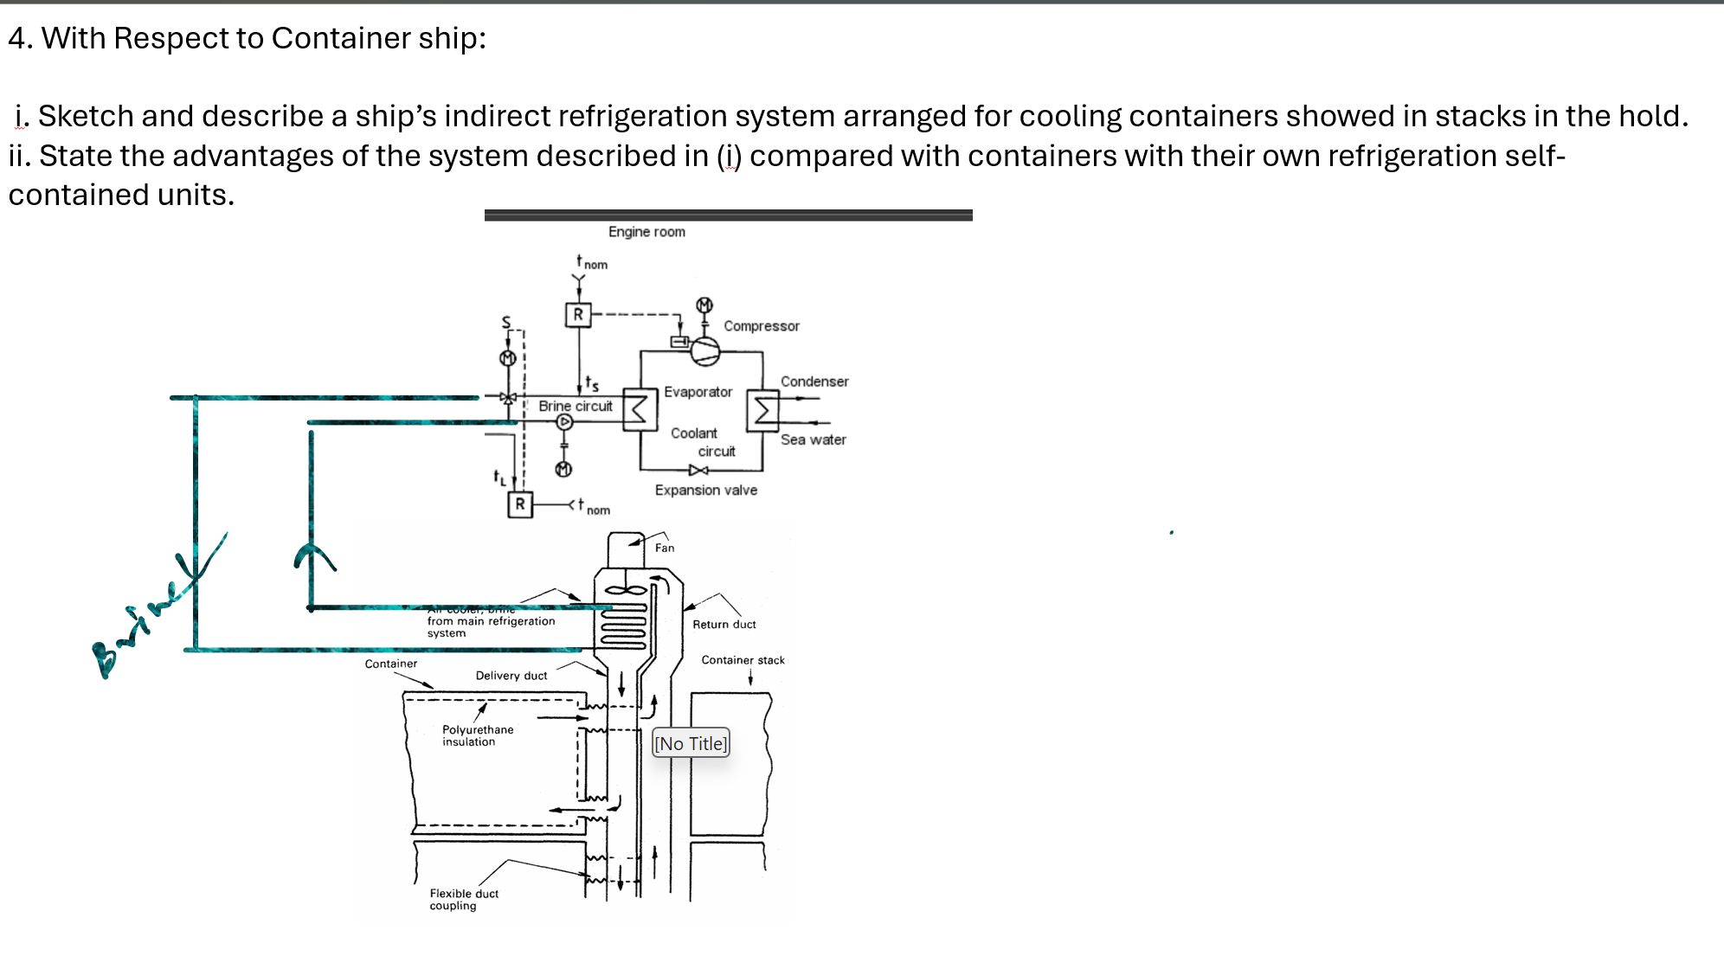

Slide 2
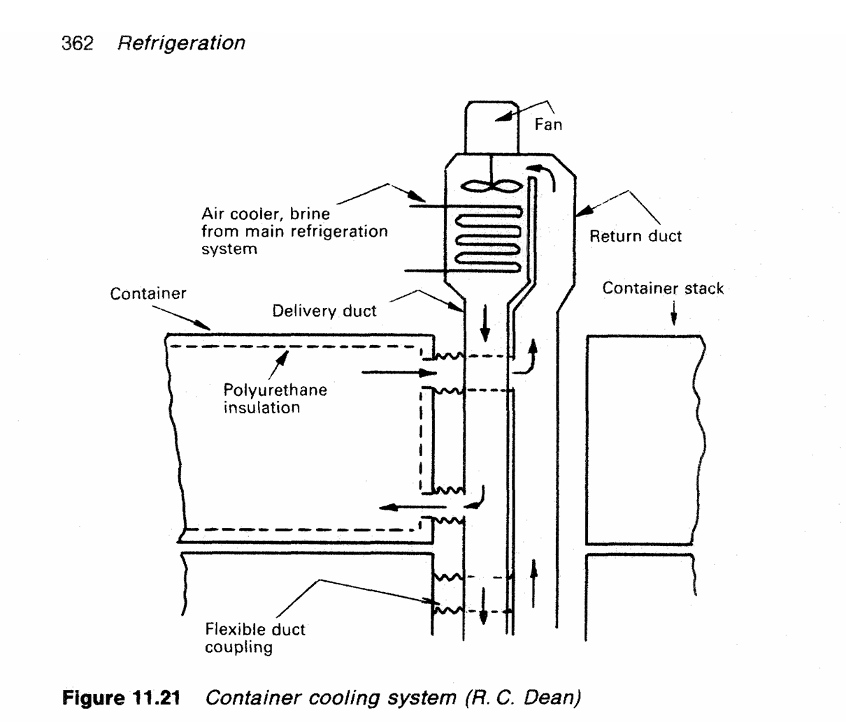
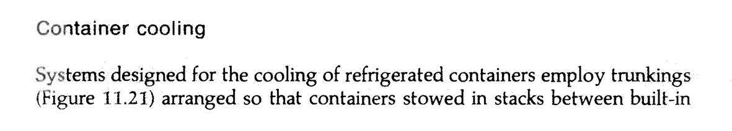
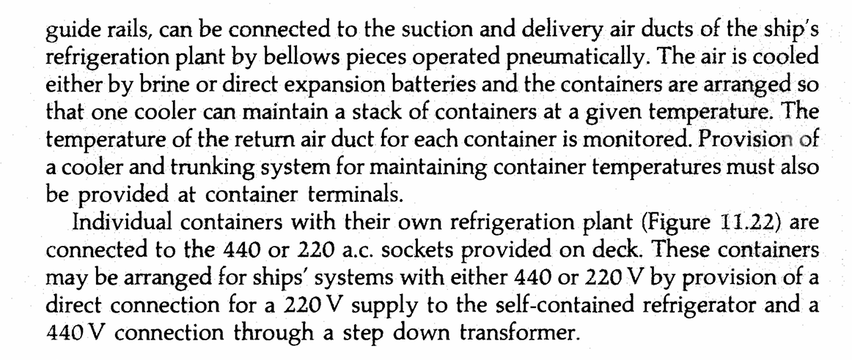
i. Sketch and describe a ship’s indirect refrigeration system arranged for cooling containers showed in stacks in the hold

Slide 3
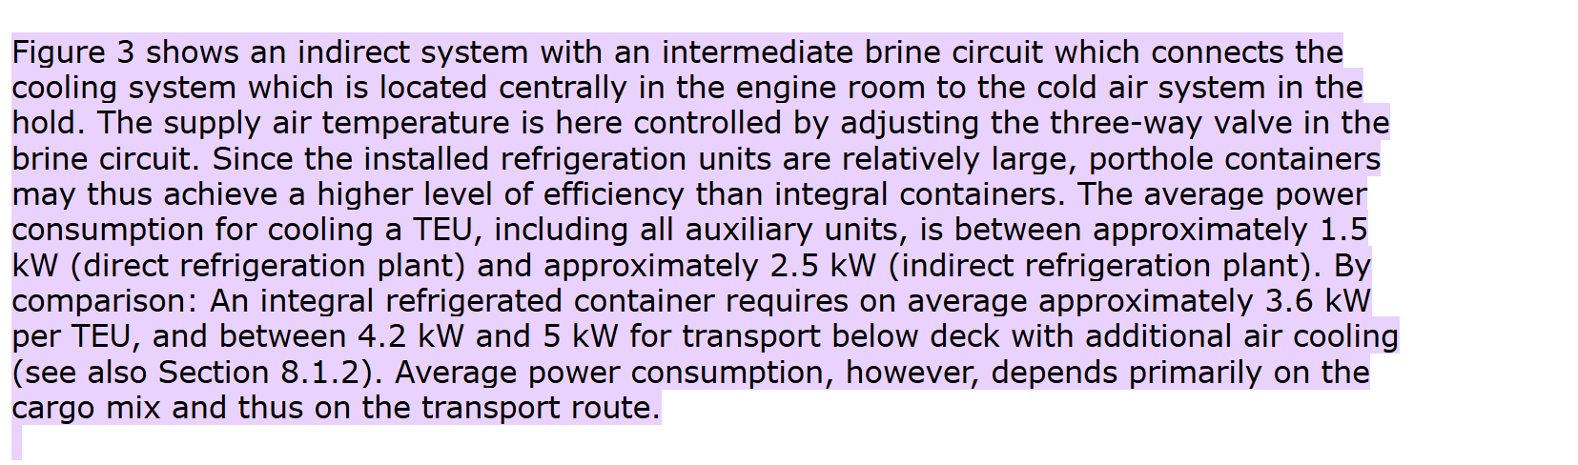

Slide 4
ii. Advantages Over Self-Contained (Integral) Units
Compared to "integral" containers (those with their own built-in refrigeration units), the centralized indirect system offers several operational benefits:
Higher Energy Efficiency: Large centralized plants are significantly more efficient than dozens of small, individual compressors. A centralized system may consume approximately 2.5 kW per TEU, whereas an integral container below deck can require between 3.6 kW and 5.0 kW per TEU due to additional ventilation needs.
Reduced Heat in Cargo Holds: Self-contained units release heat directly into the hold air. To prevent overheating, the ship must run massive ventilation fans. The indirect system transfers heat to the brine and then to sea water via the condenser, keeping the hold environment much cooler.
Simplified Maintenance: Maintenance is focused on one central plant in the engine room rather than dozens of separate units scattered across the hold. This reduces the need for specialized technicians to access cramped cargo spaces during the voyage.
Leakage Risk Mitigation: By using a secondary fluid like brine, the primary refrigerant is confined to the engine room. This minimizes the risk of toxic or flammable refrigerant leaks in the cargo holds or among personnel.
Centralized Monitoring: Temperatures for an entire stack can be monitored and controlled from a single point, allowing for easier adjustment and better cargo safety.
Increased Cargo Capacity: Porthole containers often provide more internal storage space because they lack the bulky internal refrigeration machinery found in self-contained units

